Slide 1
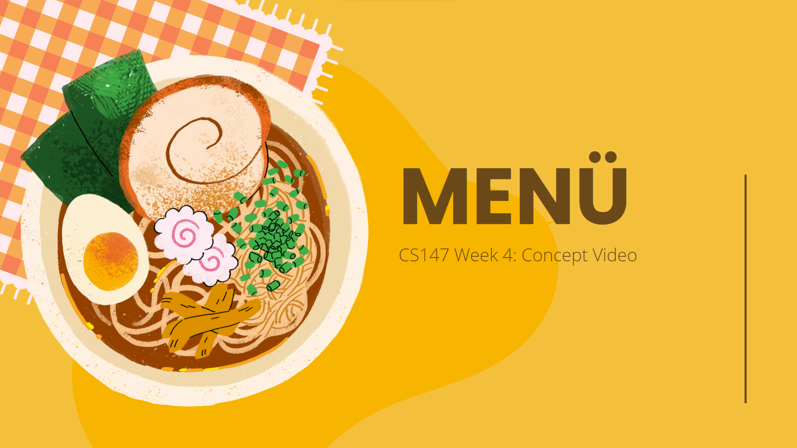

Slide 2
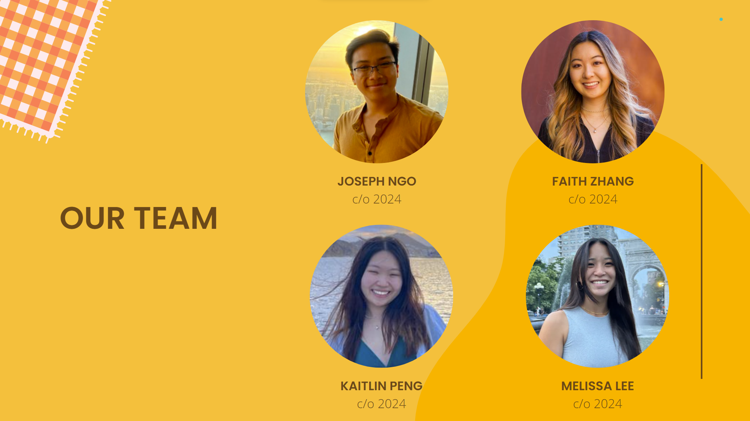

Slide 3
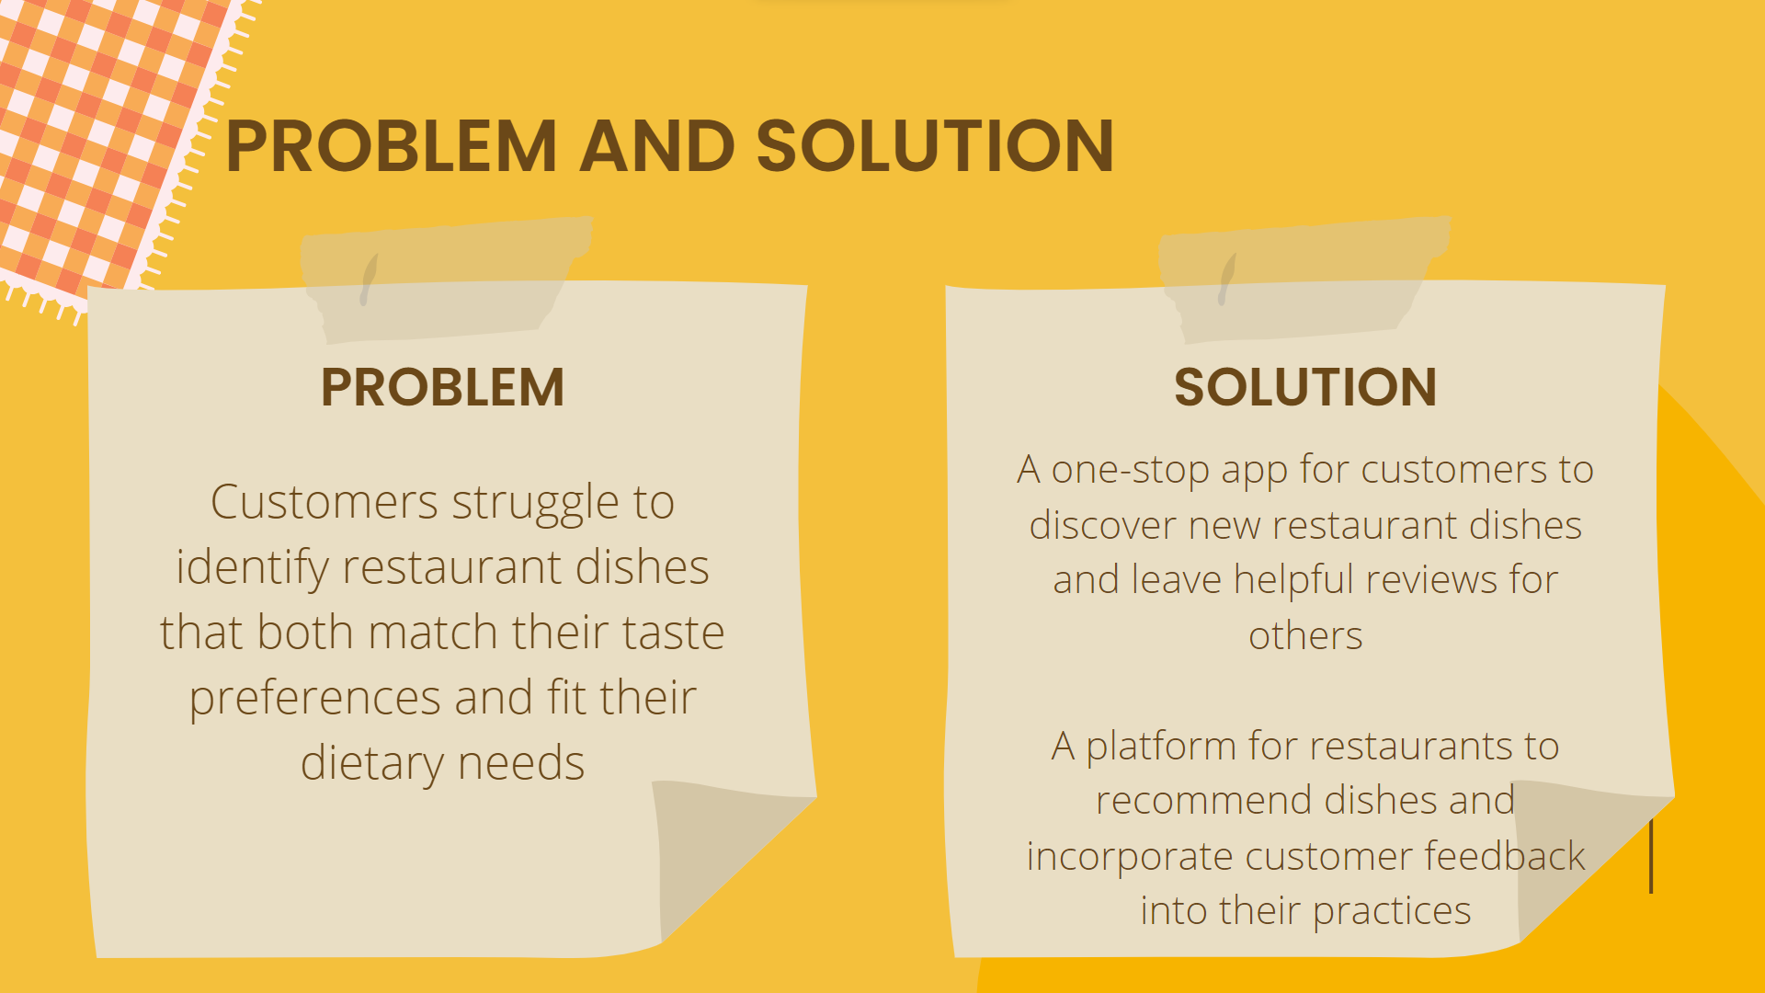

Slide 4
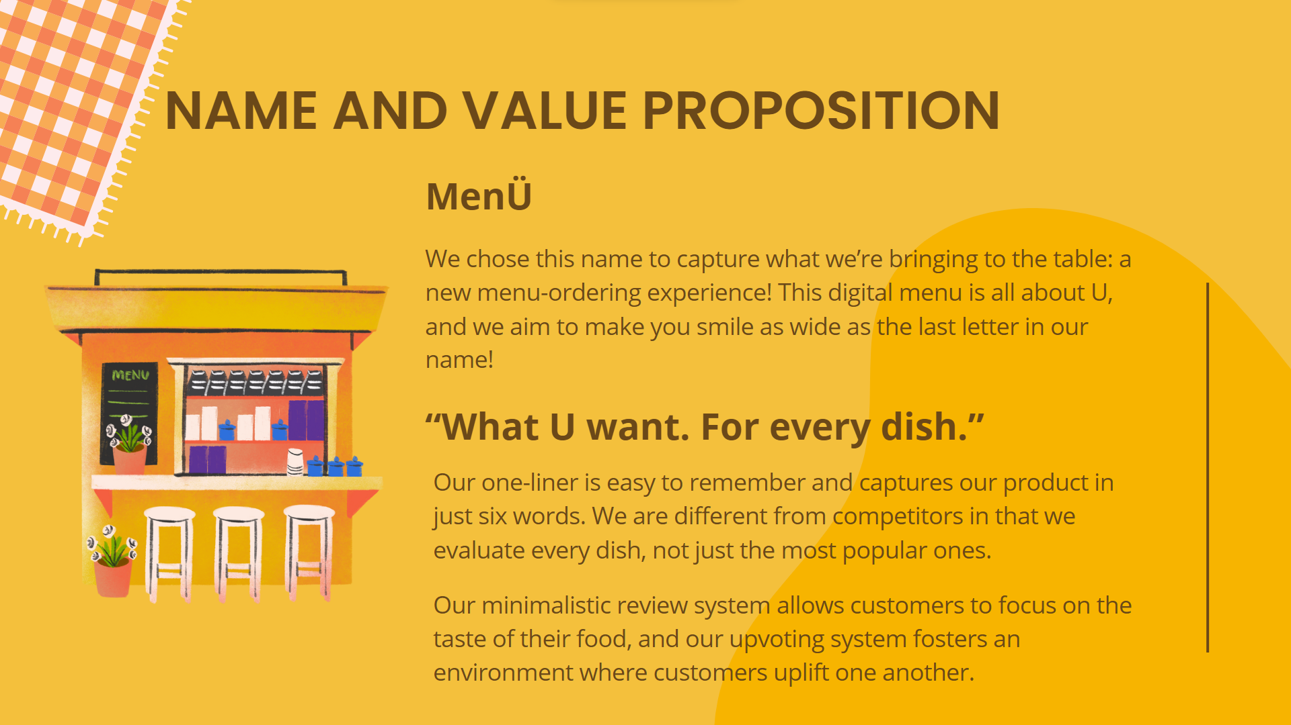

Slide 5
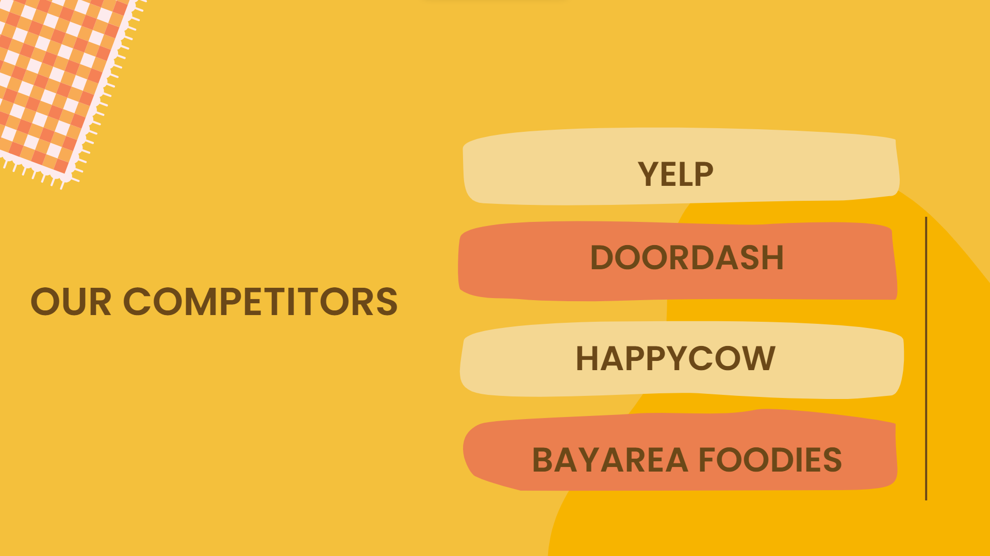

Slide 6
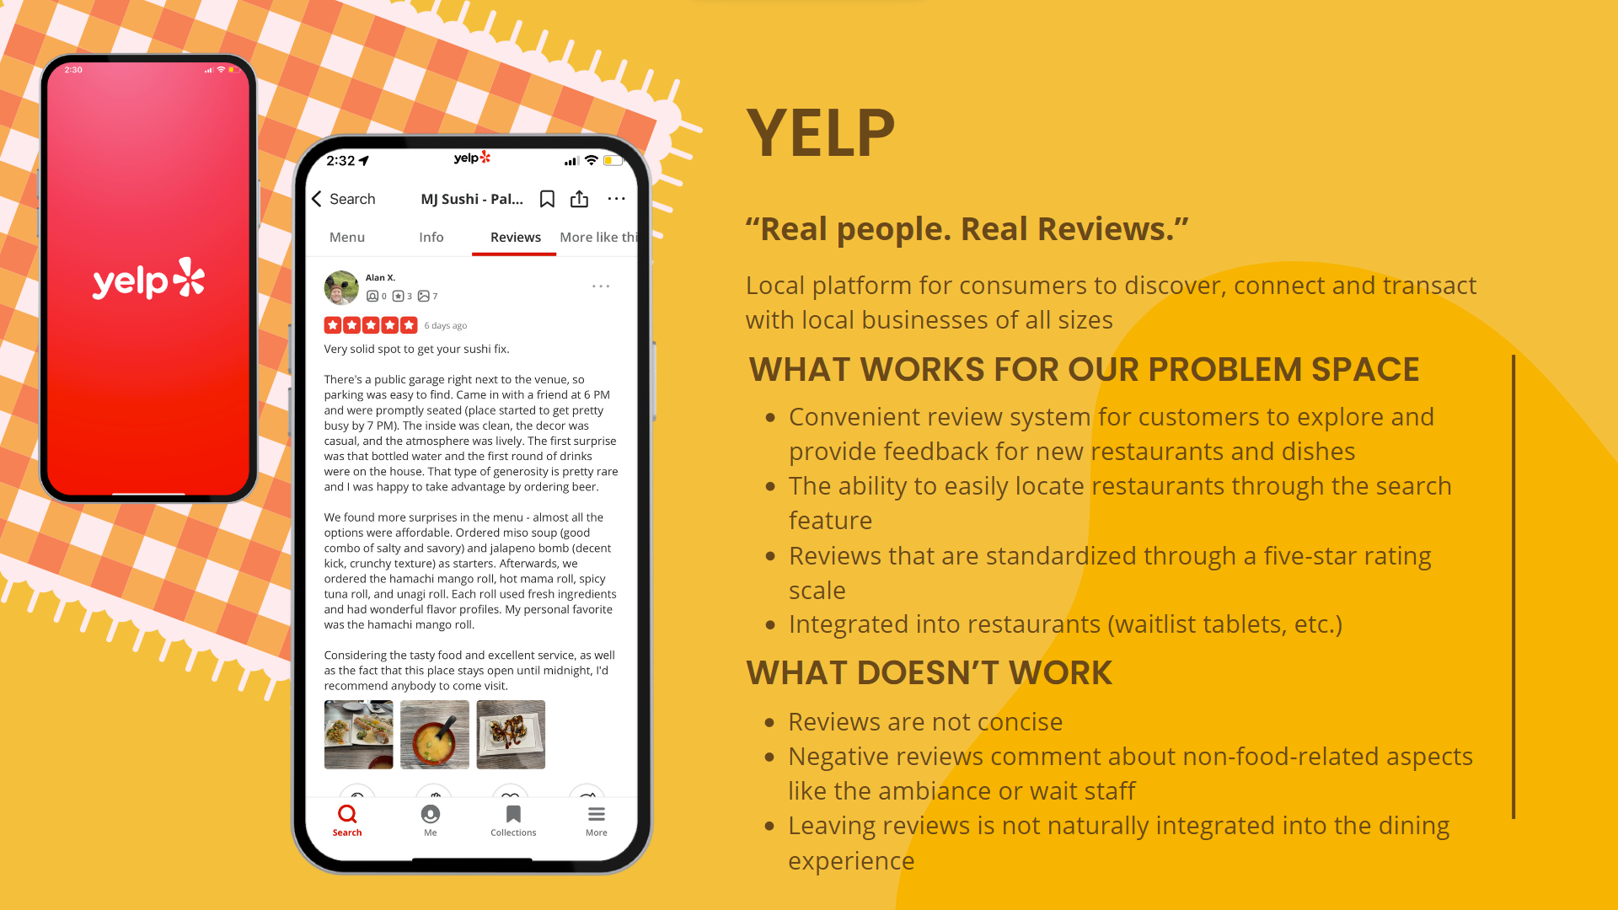

Slide 7
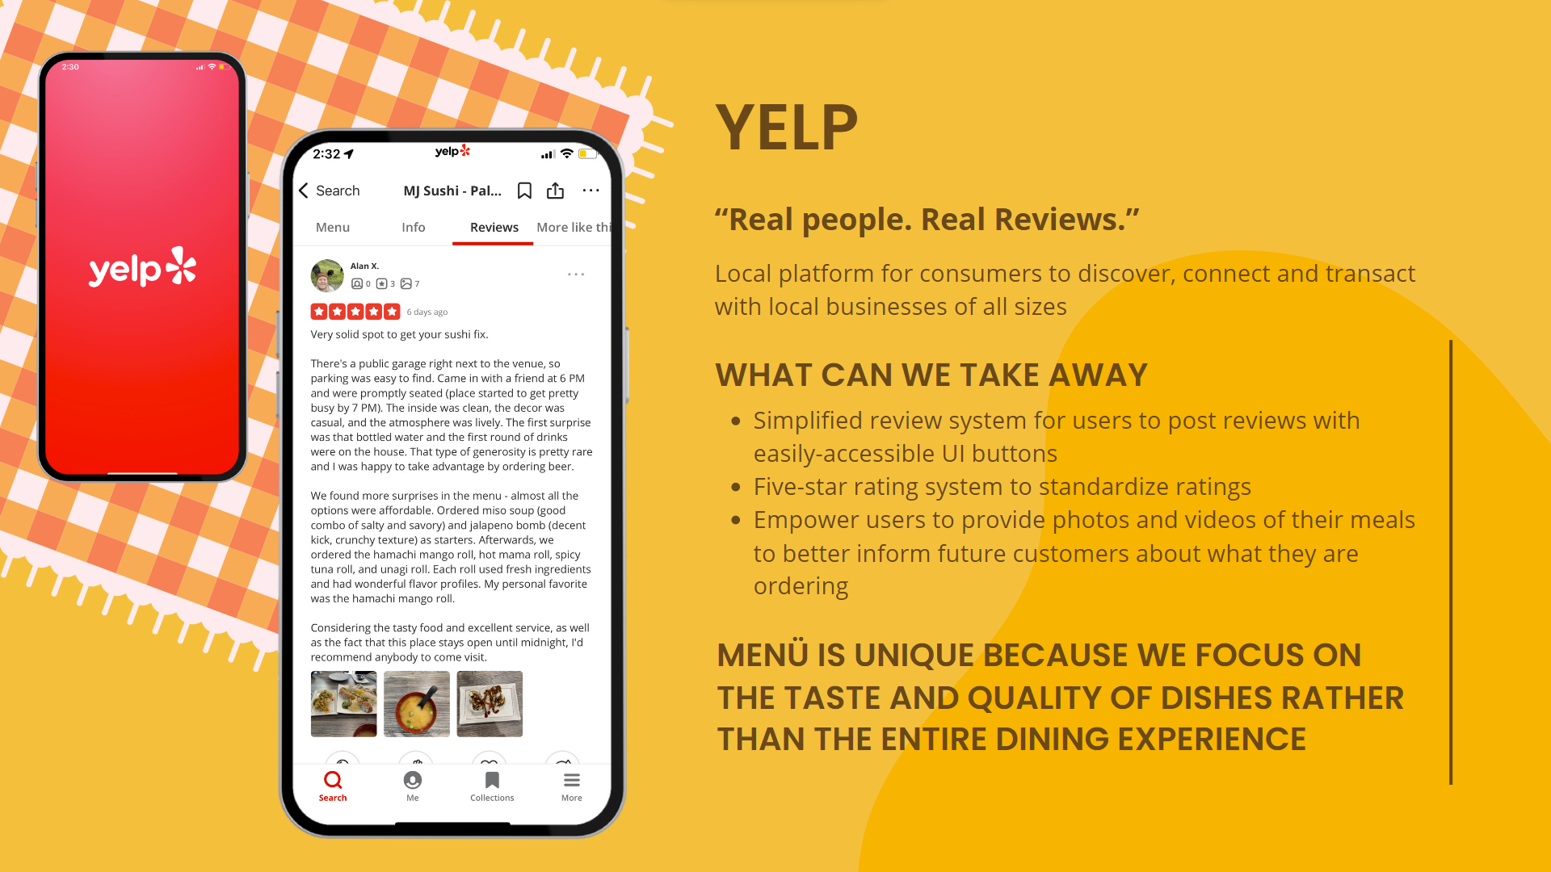

Slide 8
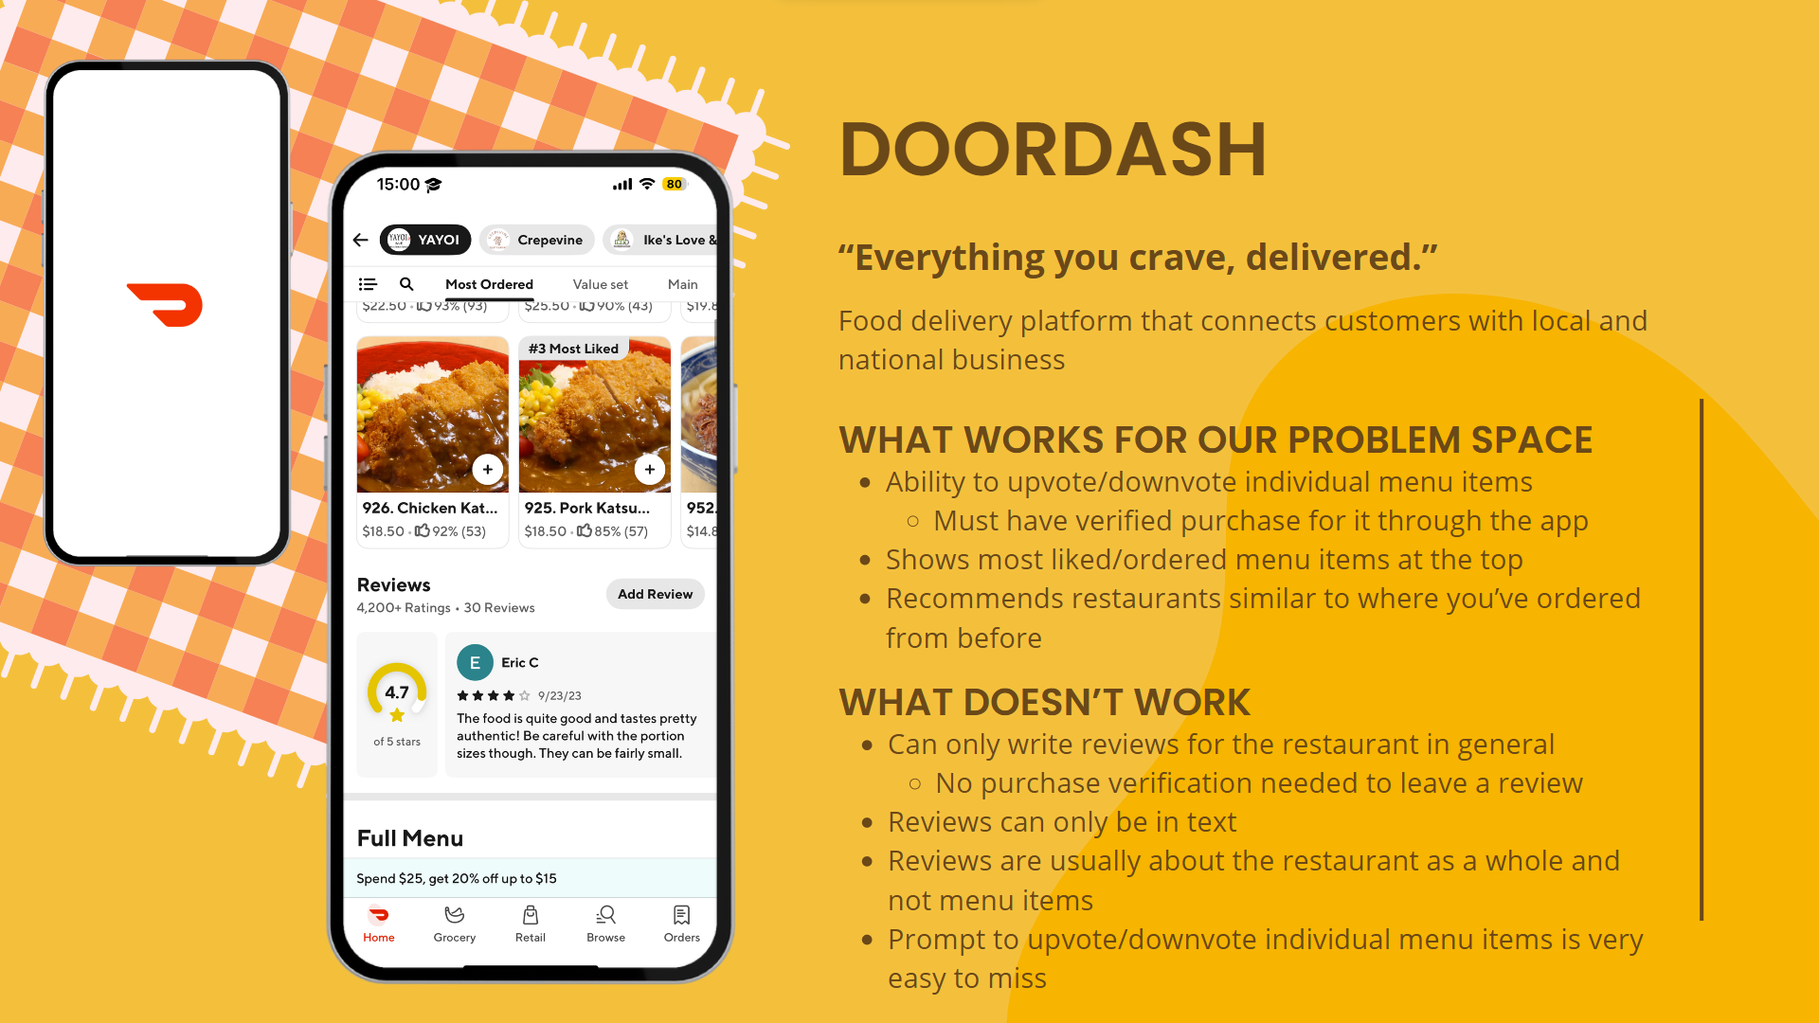

Slide 9
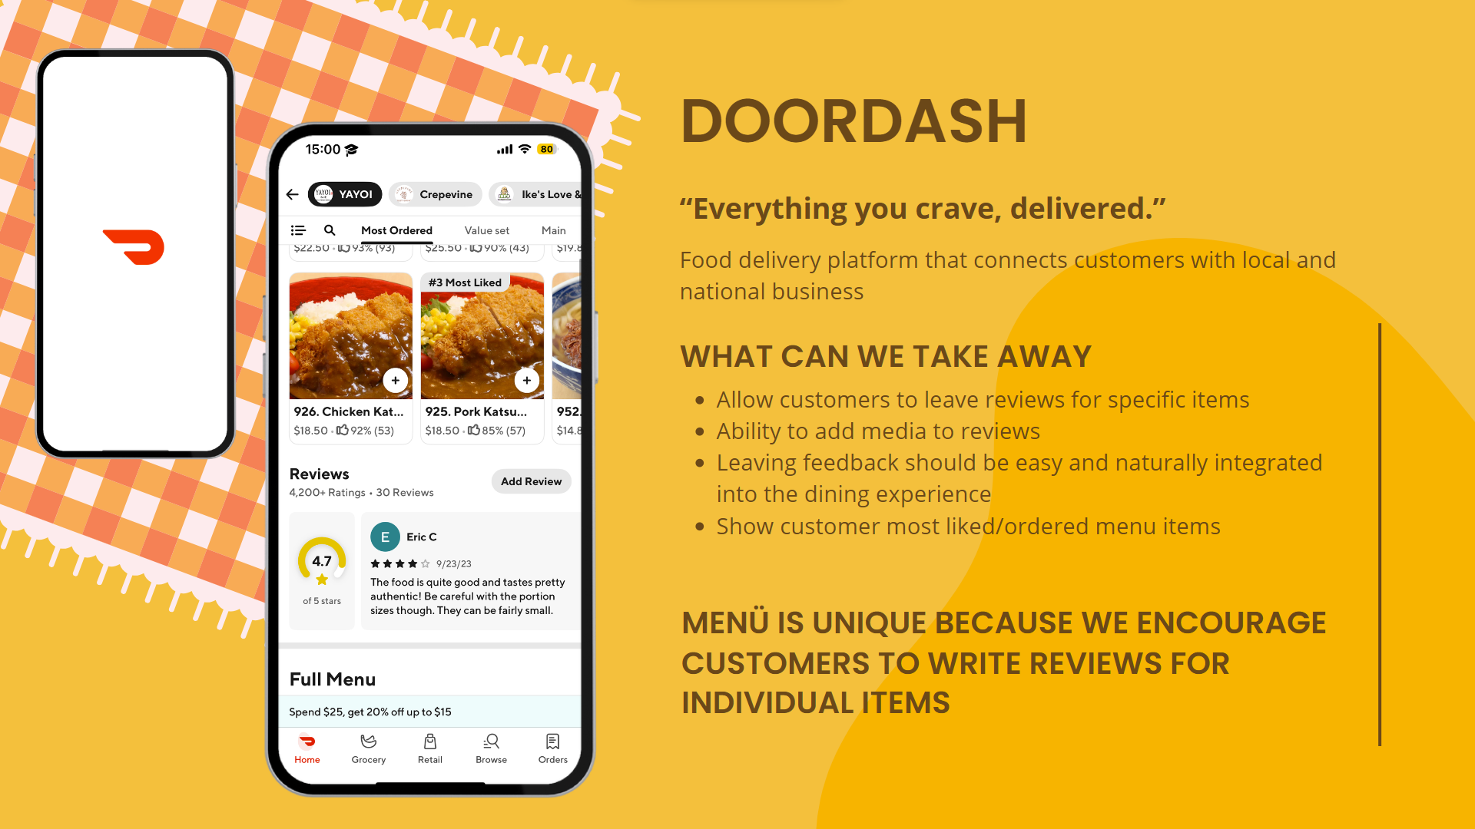

Slide 10
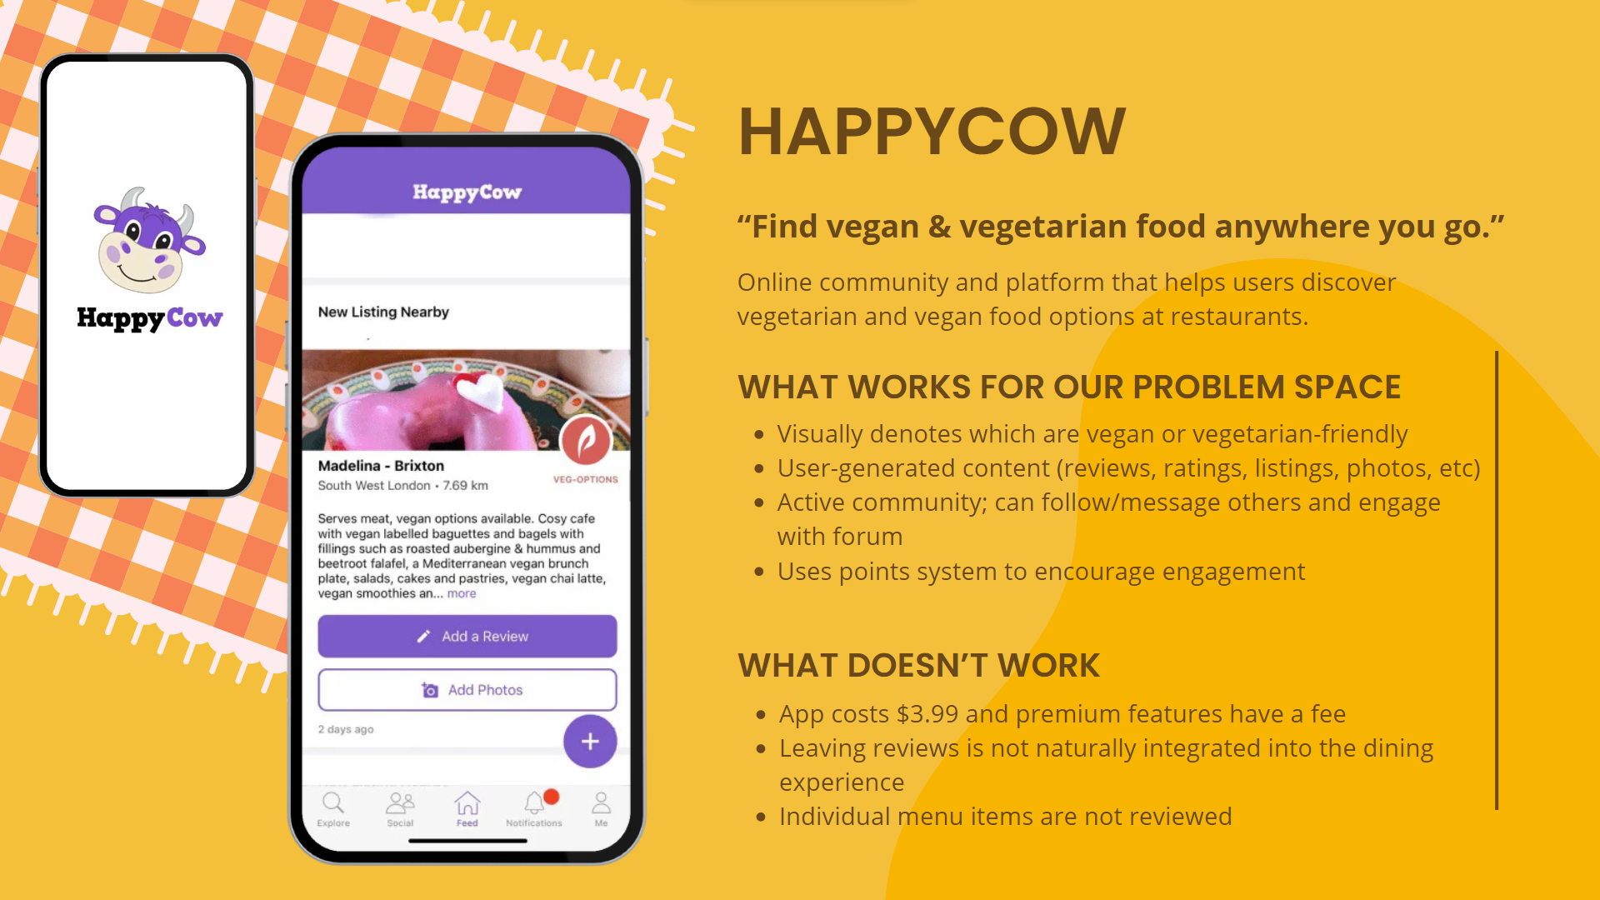

Slide 11


Slide 12
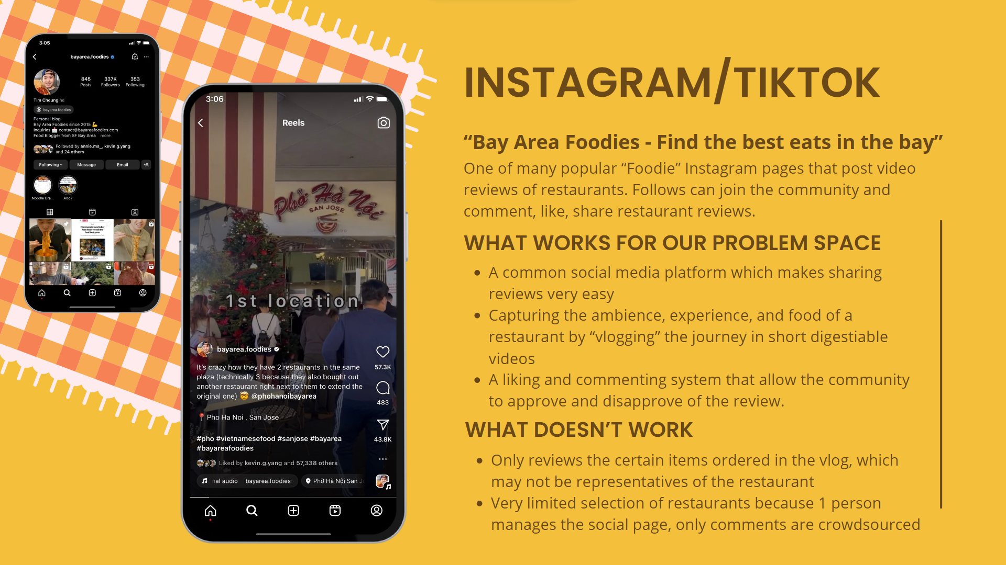

Slide 13
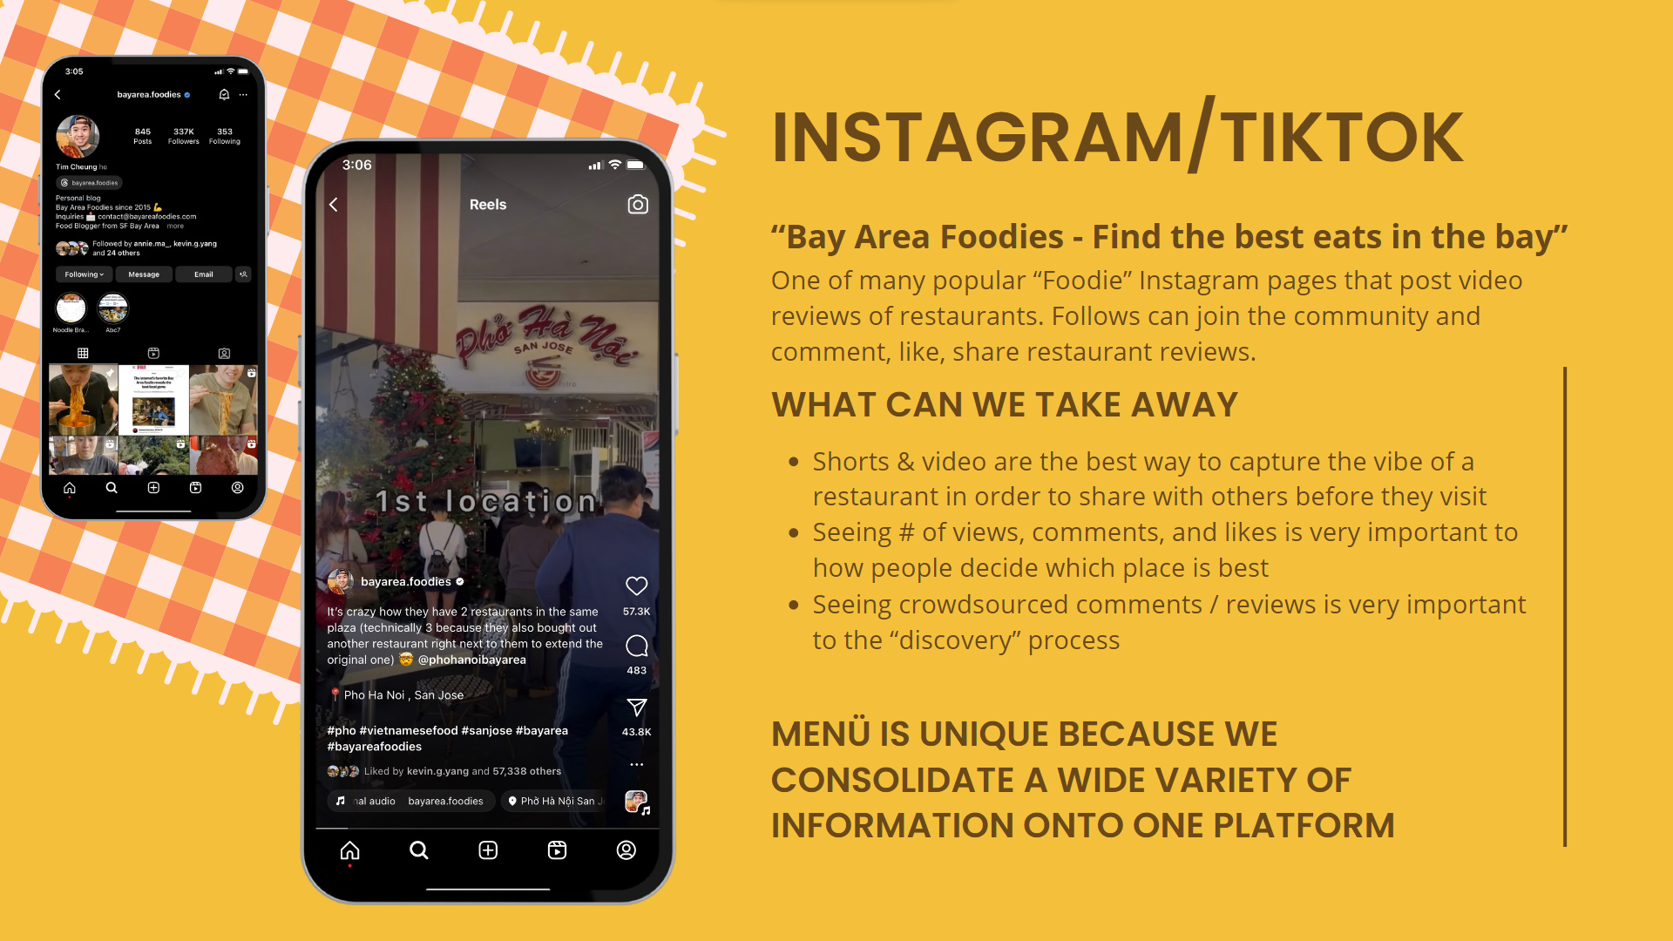

Slide 14
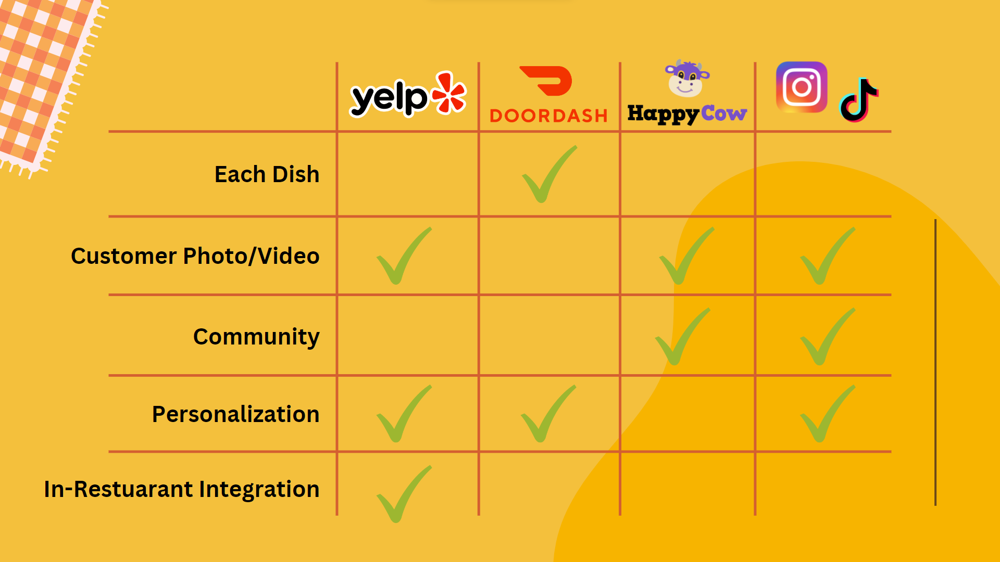

Slide 15
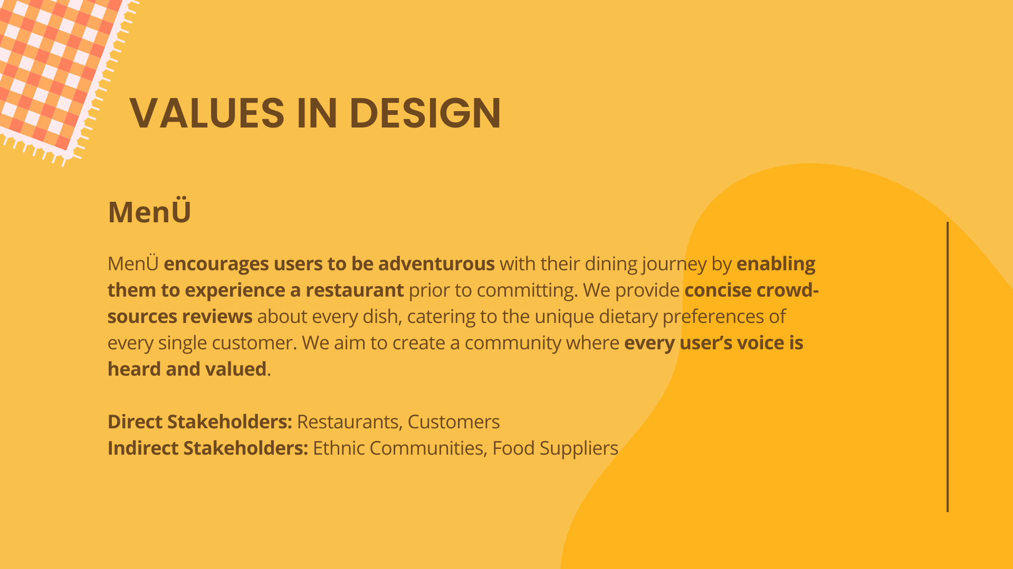

Slide 16
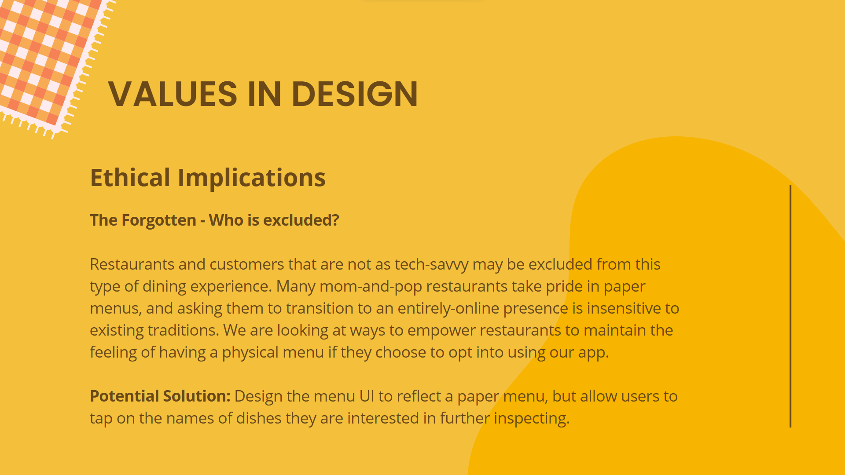

Slide 17
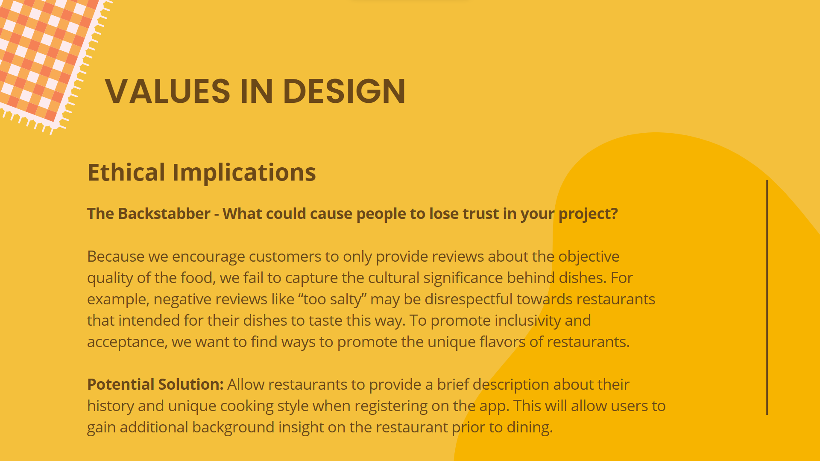

Slide 18
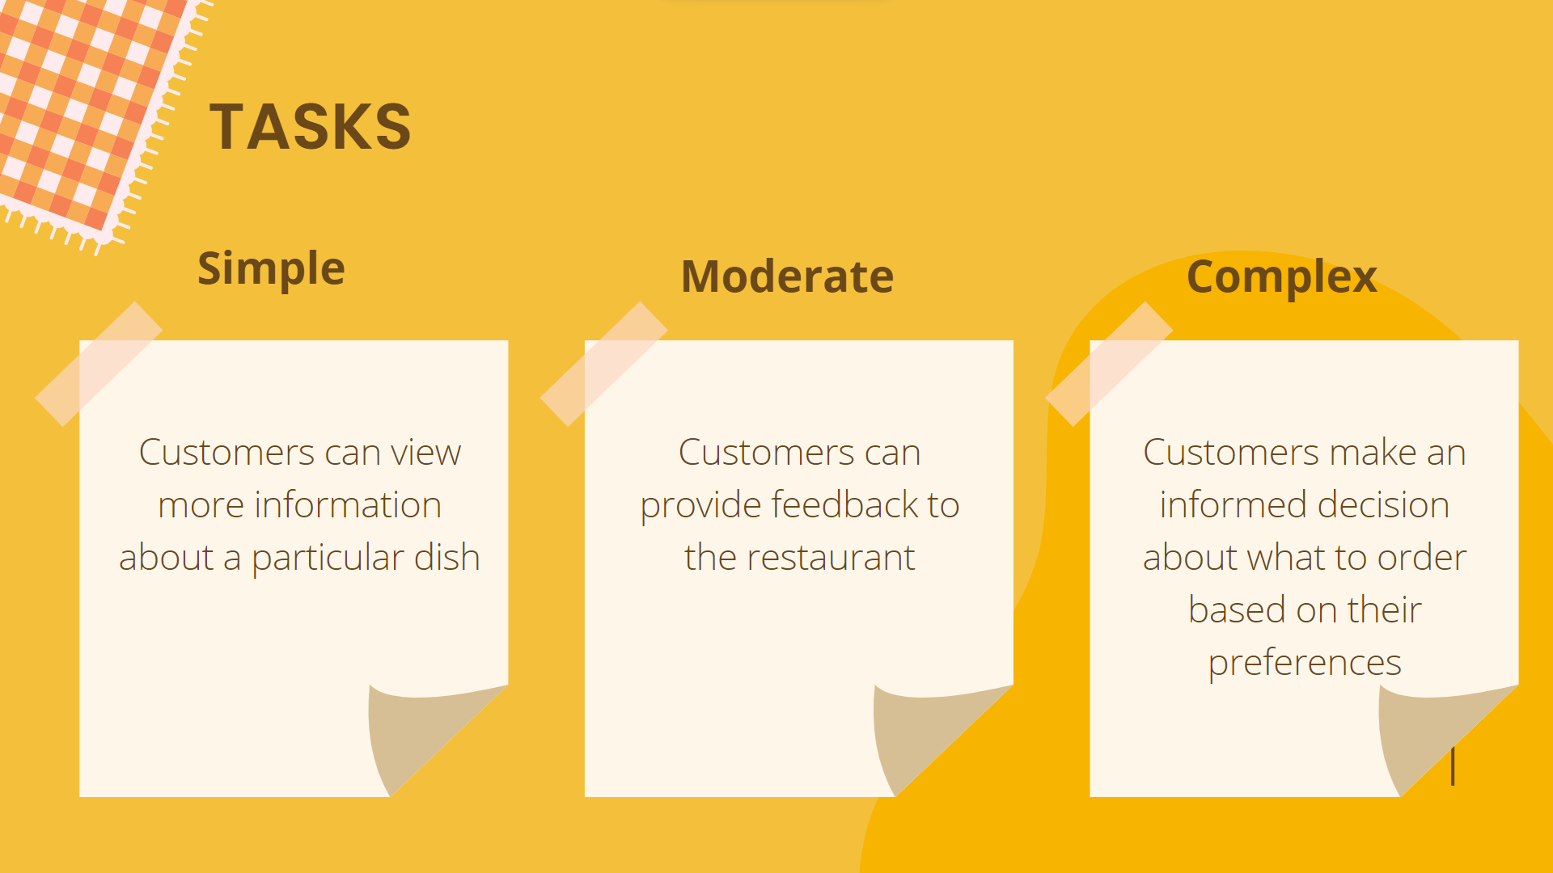

Slide 19
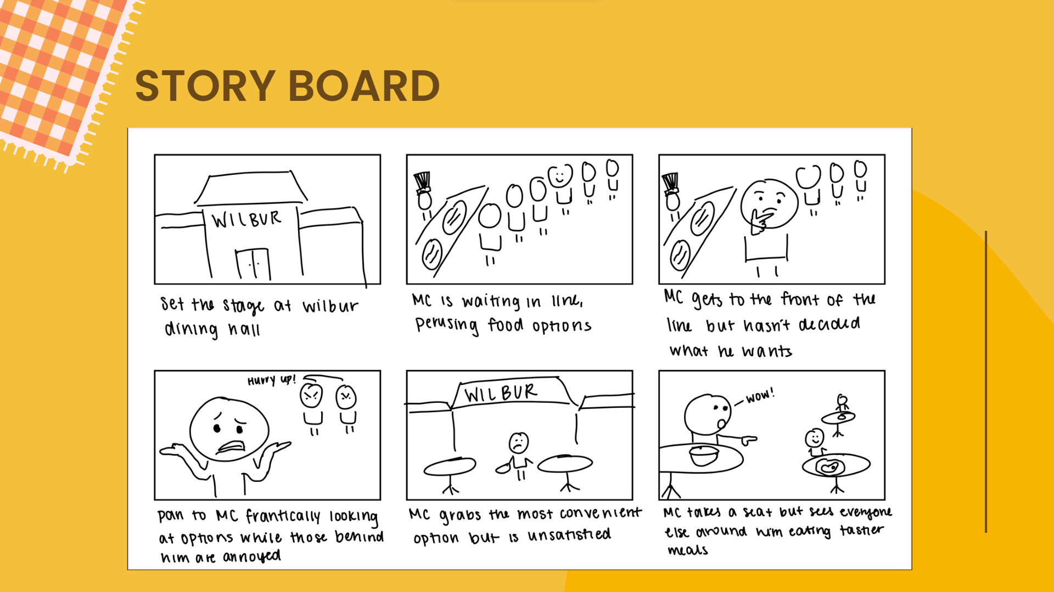
Notes:
Context
Indecisive individual struggles with ordering food that he is satisfied with.
Actors
MC: Joe - indecisive, shy, doesn’t want to be a bother → confident in ordering person
Crush: Tracy
Servers: Melissa, Kaitlin, Zach, other Bob residents
Conflict / resolution
Conflict: Gets invited to go out for dinner by his crush but is nervous that he will annoy her because of his indecisiveness and will end up ordering something bad.
Resolution: Gets introduced to menU, which allows him to narrow down options based on needs and preferences, provides comprehensive data and information about each menu item to better inform his decisions, and allows him to order something that he will enjoy in a quick and efficient manner, ultimately leading him to be confident in his decision-making.

Slide 20
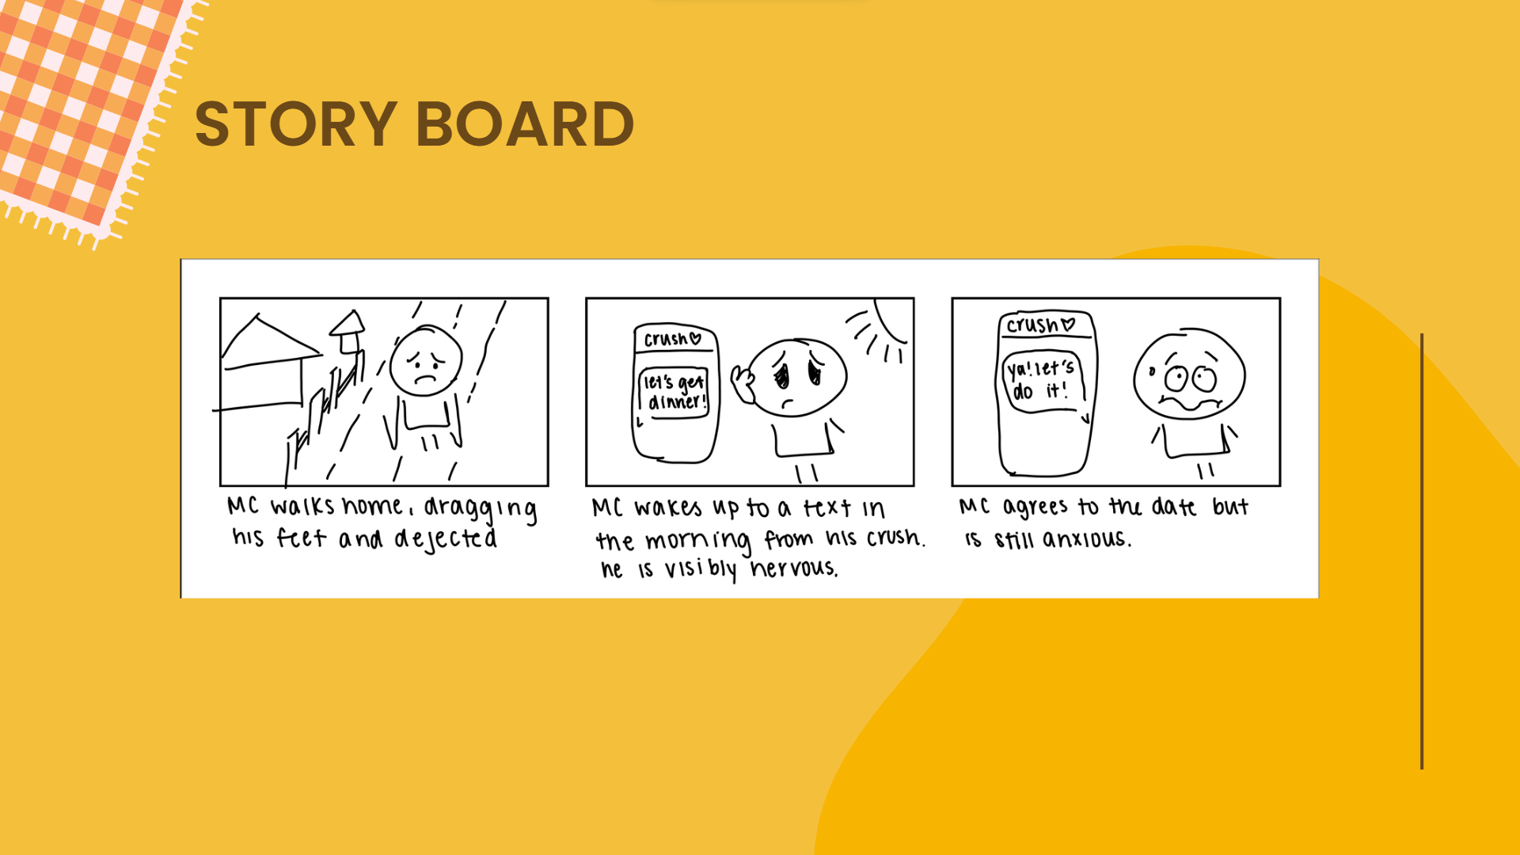

Slide 21
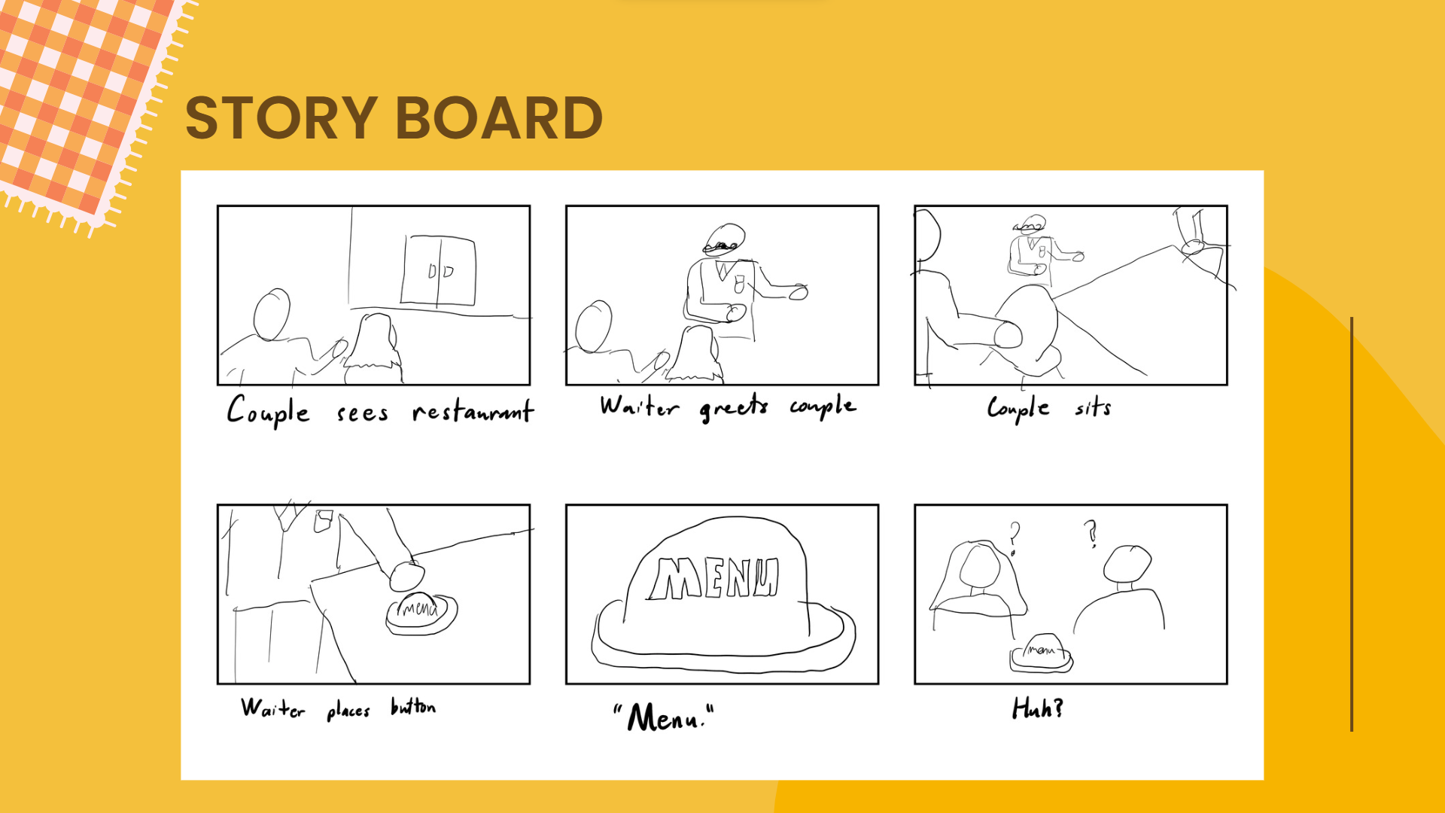

Slide 22
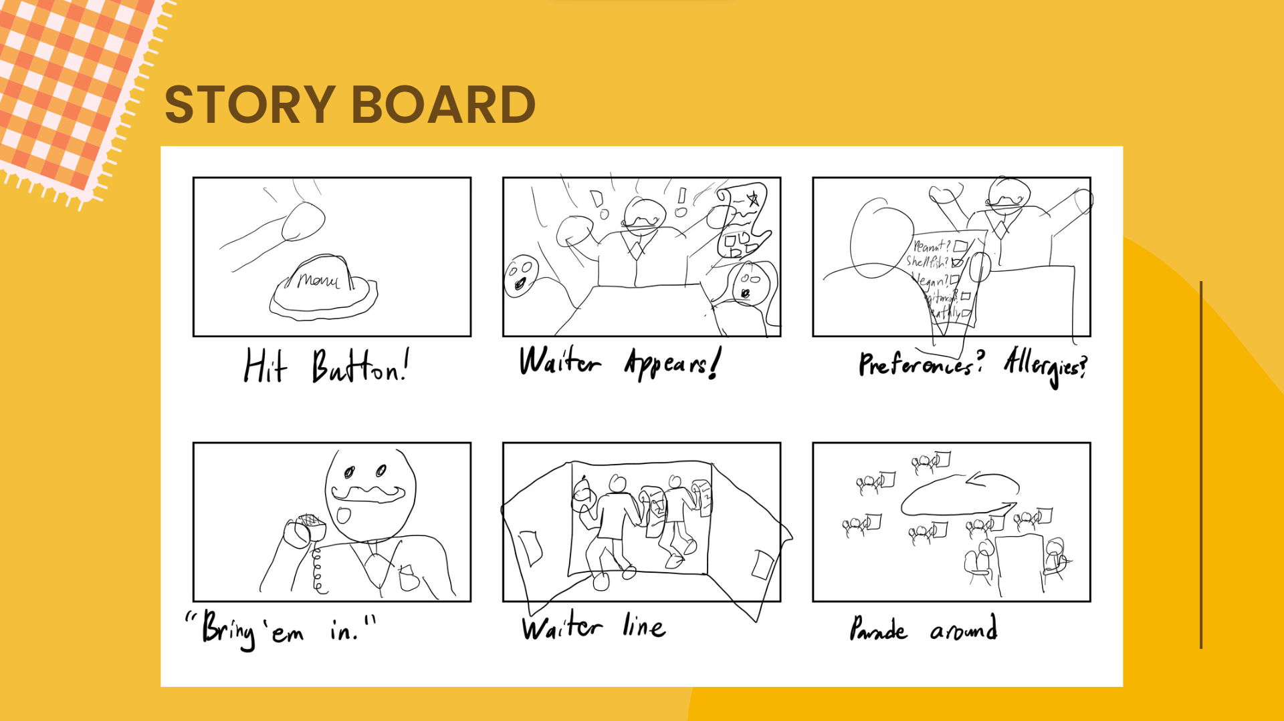

Slide 23
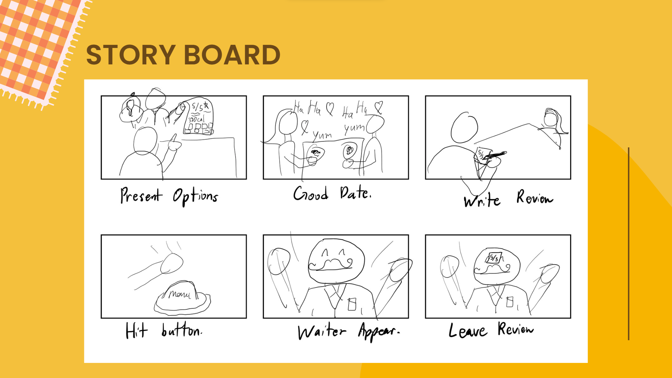

Slide 24

